Slide 1
natural induction and “global adaptation in networks of selfish components”
Richard Watson University of Southampton, UK
Notes:
Toronto 2022 Jan 19th – Denis Walsh

Slide 2
Introducing Natural induction – an antidote to universal Darwinism
How it works: ‘self-modelling’ dynamical systems
Numerical illustration (without any natural selection)

Slide 3
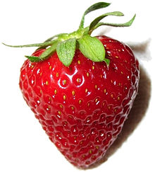
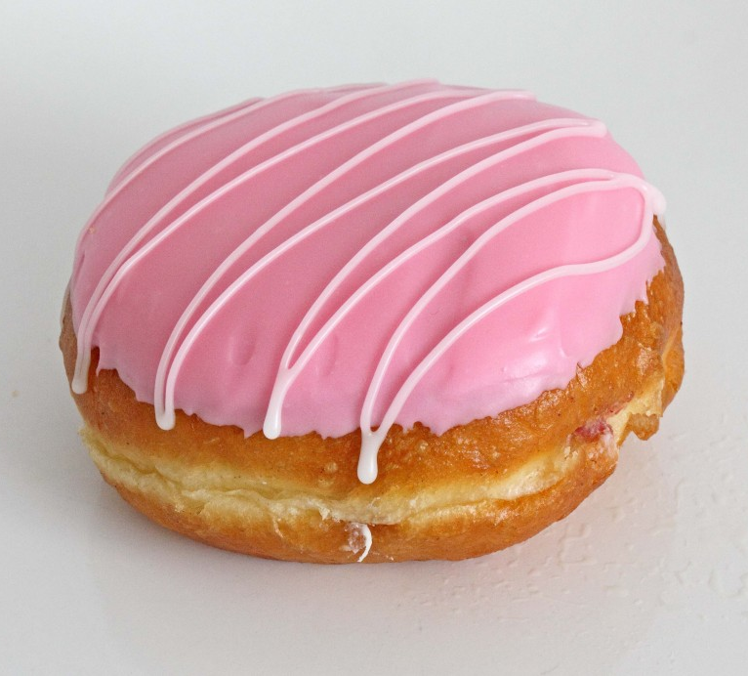
What is Induction?
Induction is the production of general rules from specific examples.
This colourful thing tastes good,
That colourful thing tastes good,
(induction)
Colourful things taste good.
(Inductions do NOT follow logically from the observations)

Slide 4
There are two kinds of people in the world
1. Those who can extrapolate from incomplete data

Slide 5
Induction is fundamental to learning:
Learning without induction:
You do well on the examples you have seen before
Just memory (rote learning)
Learning with induction:
You do well on the examples you have seen before AND other novel cases.
Generalisation (proper learning)
How do you do that??
How brains do it might be complicated, but..

Slide 6
neural networks in machine learning = Associative induction
Associative induction = Learning what goes together
This only requires very simple local rules: neurons that fire together wire together = the more two things co-occurred in the past, the more they become likely to co-occur in the future
= positive feedback on correlations
can do all sorts of cool things: associative memory and recall, classification, reinforcement learning, generalisation, low-dimensional models of high-dimensional data, learning to solve constraint optimisation problems better with experience

Slide 7
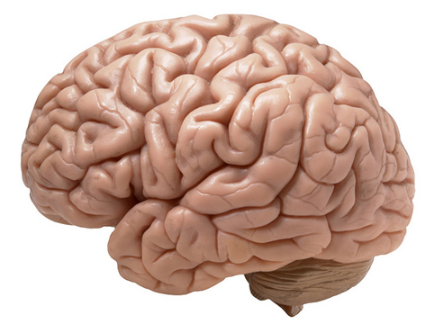
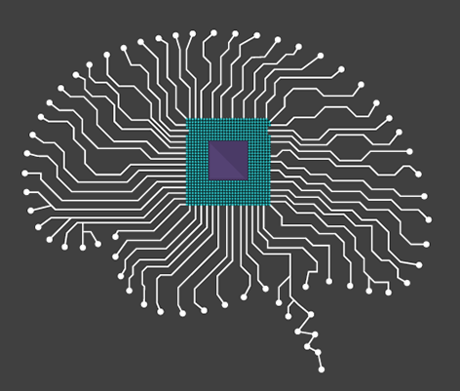
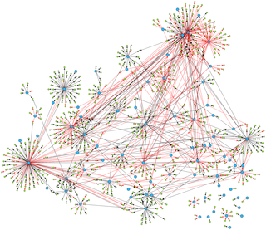
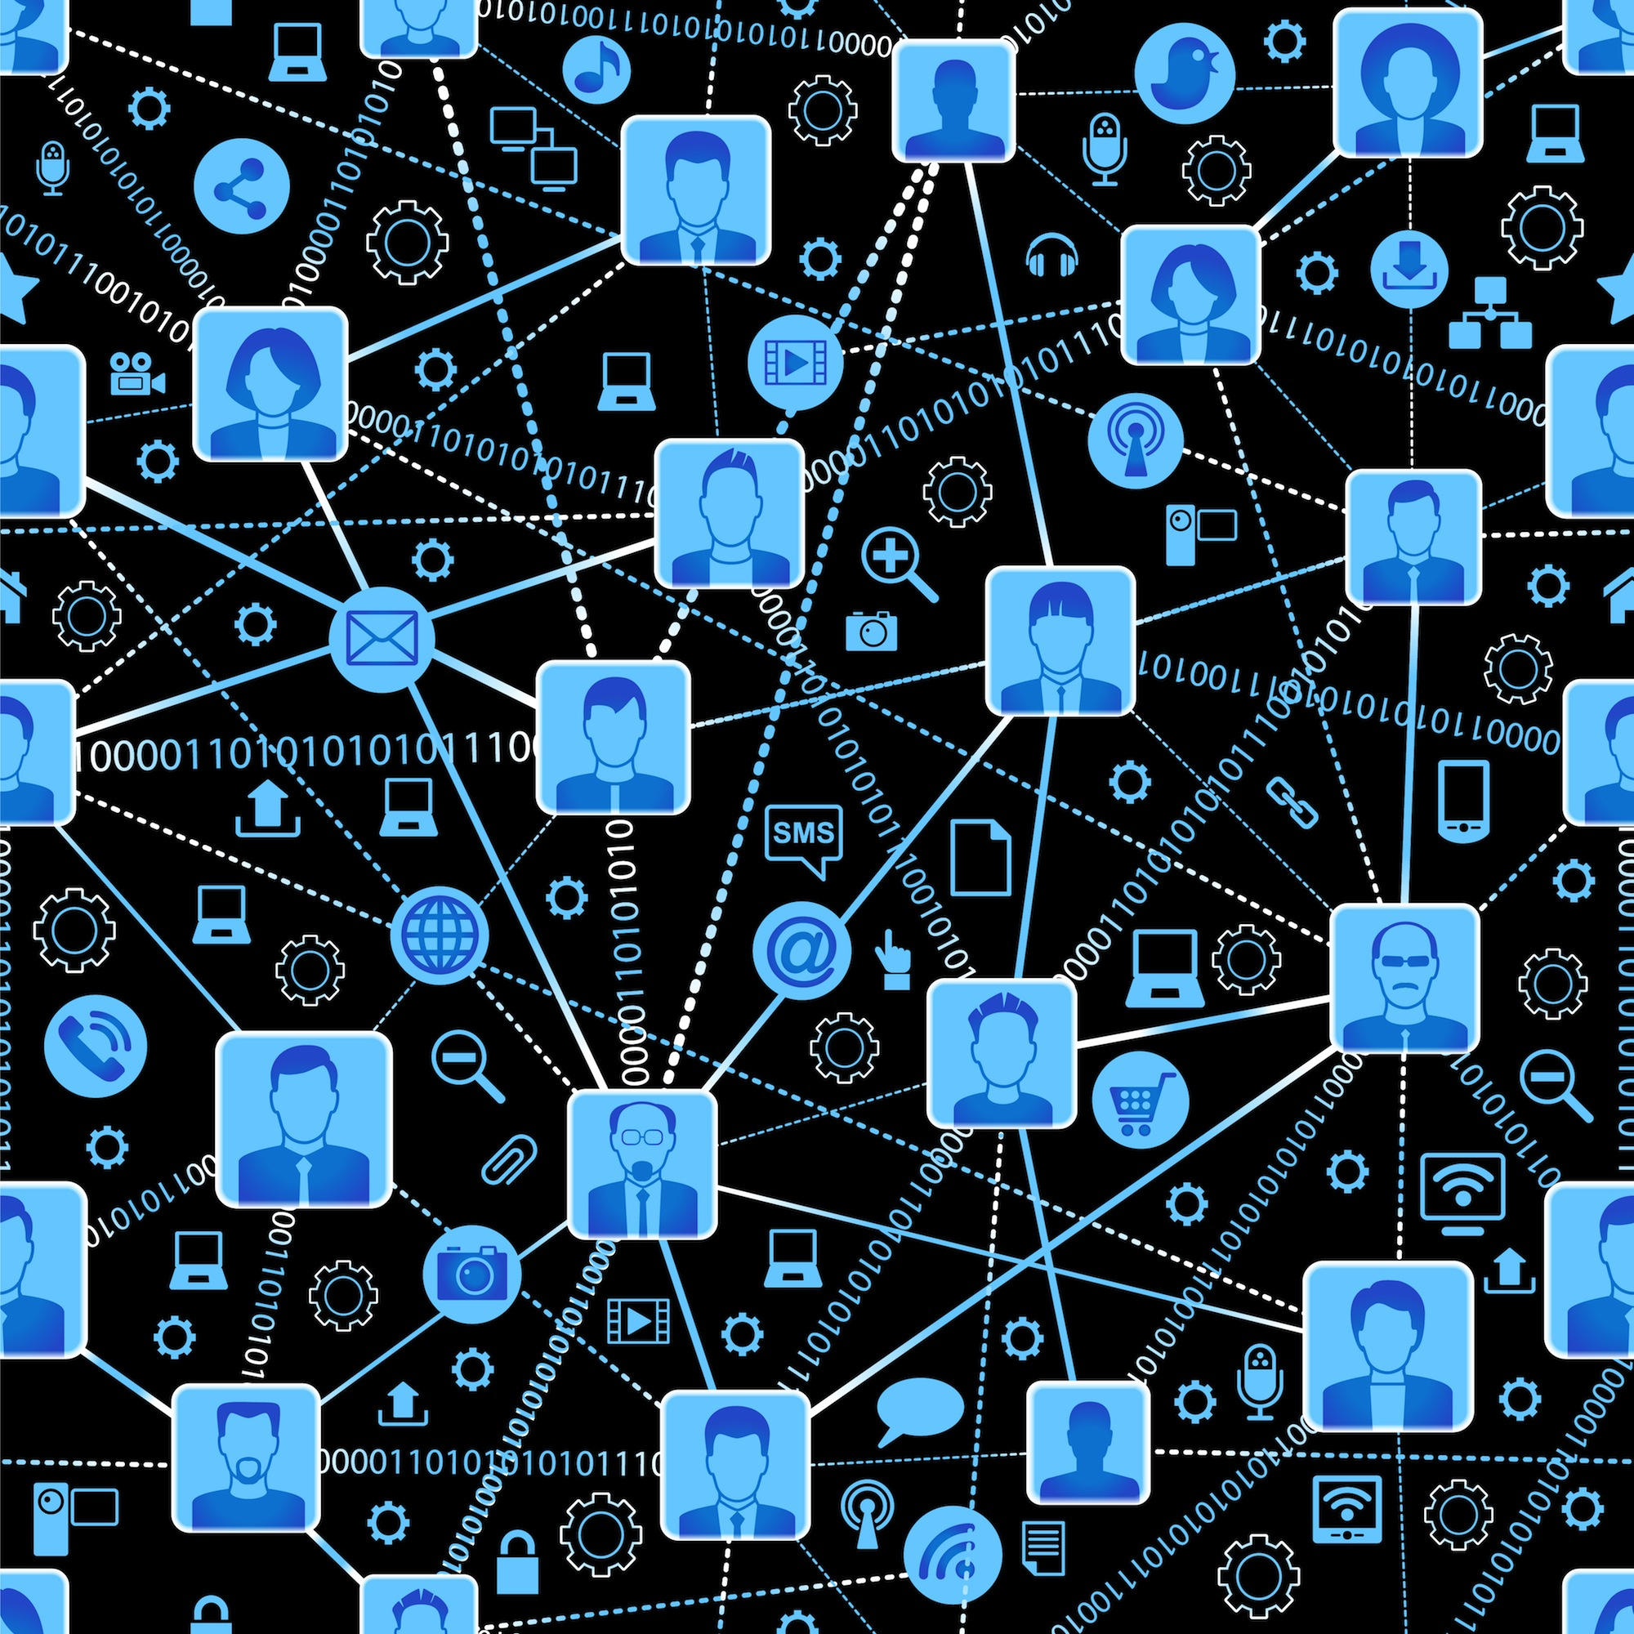
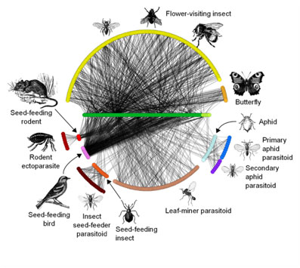
Natural induction
A natural process that does induction spontaneously (not by design or selection for that function)
It is change in the connective organisation of a dynamical system that results indirectly from the pattern of forcing it experiences, resulting in learning and increased optimisation ability.
Evolved induction
Designed induction
Selected/designed for the purpose of doing induction
Natural induction - occurs spontaneously in dynamical systems w. suitable properties

Slide 8
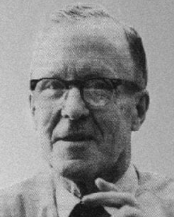
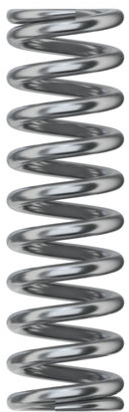
How natural induction works in 4 easy steps
global adaptation ability in networks of simple components (E.g. in a learning neural network)
Unsupervised distributed associative learning (no centralised control or global feedback)
positive feedback on correlations
Viscoelastic connections (=connections that give-way slightly under stress, make current state more likely to occur again. Natural, energy minimisation)

Slide 9
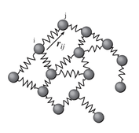
How natural induction works in 4 easy steps
global adaptation ability
Like a learning neural network, naturally (without selection or design).
Networks of viscoelastic connections

Slide 10
Applies to any dynamical system described by a network of viscoelastic connections, experiencing episodic stress or perturbation
viscoelastic = connections ‘give-way’ slowly/a little bit under stress
The differential stress on connections is determined by the ‘experience’/’history’ of the system – eases frustrations over multiple episodes. This results in an associative memory of past experience, held in connective structure of the system
Because its associative, it can generalise – finds better solutions to constraint optimisation problems with experience = ‘systemic intelligence’ (ability to find harmonious configurations, that resolve more internal conflict)

Slide 11
In more detail…

Slide 12
induction requires -> modelling underlying regularities
000001
111101
001110
110010
111101
modelling what things go together.
e.g. Hebbian learning

Slide 13
Induction => Generalisation
A correlation model records information about multiple patterns.
Store and recall multiple patterns. Associative memory
Model can also be used to generate novel patterns that are from the same class Generalisation
000001
111101
001110
110010
111101
Many points in feature space
One point in model space
001110
111110

Slide 14
A. Dynamical systems as correlation models
e.g. Hebbian learning (in a Hopfield network)
observations
001110
111101
000001
110010
111101
001110
111110

Slide 15
Generating from the model
A model of correlations that have been observed
Relax state variables = find local minima in energy function
000001
111101
001110
110010
Repeated relaxation generates distribution of samples from model

Slide 16
B. Dynamical systems as constraint solvers
Problem definition
Represents a problem as a system of constraints that must be resolved
Relaxing state variables locally resolves conflicting constraints
000001
111101
001110
110010
Repeated relaxation finds distribution of locally optimal solutions to the constraint problem (Hopfield and Tank 1986).

Slide 17
Adaptation by induction
e.g. in a learning Hopfield network
A. Correlation learning
+
B. Constraint solving
Adaptation by induction
(improved optimisation)
Watson, R.A., Buckley, C.L., Mills, R.M. (2010) Optimisation in ‘Self-modelling’ Complex Adaptive Systems. Complexity. 16(5):17-26.

Slide 18
Adaptation by induction
Use each locally optimal solution to update the interactions (Watson et al)
001110
111101
000001
110010
111101
001110
111110
Relaxing state variables locally resolves conflicting constraints
000001
111101
001110
110010
Repeated relaxation finds distribution of locally optimal solutions to the constraint problem (Hopfield and Tank 1986).

Slide 19
Adaptation by induction
Information found by relaxing state variables is fed back to update interaction variables
Relaxing state variables locally resolves conflicting constraints
000001
111101
001110
110010
Repeated relaxation finds distribution of locally optimal solutions to the constraint problem (Hopfield and Tank 1986).
Positive feedback on correlations

Slide 20
Adaptation by induction
Information found by relaxing state variables is fed back to update interaction variables
000001
111101
001110
110010
the new model has enlarged attractors for past solutions

Slide 21
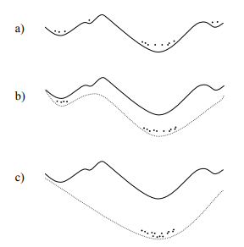
Increases basin of good solutions and removes small local optima
Increases reliability of finding good solutions
Because enlarges basins in proportion to time visited and time visited is proportional to quality

Slide 22
Adaptation by induction
Information found by relaxing state variables is fed back to update interaction variables
000001
111101
110001
001110
110010
And for new solutions it hasn’t found before (generalisation)

Slide 23
Adaptation by induction (a ‘self-modelling’ dynamical system)
Information found by relaxing state variables is fed back to update interaction variables
111101
000001
By generalising from local optima, system learns to find better solutions to the original conflicting constraints
001110
110001
110010

Slide 24
How natural induction works in 4 easy steps
global adaptation ability in networks of simple components (E.g. in a learning neural network)
✓
Unsupervised associative learning
✓
positive feedback on correlations
Viscoelastic connections (=connections that give-way slightly under stress, make current state more likely to occur again. Viscoelastic connections are natural)

Slide 25
Correlation learning (associative induction) happens naturally
Doesn’t need any fancy learning mechanisms/algorithms… only requires positive feedback on correlations – the more two things co-occur, the more the connection between them changes in the manner that makes them co-occur more
Such positive feedback will occur spontaneously in any dynamical system described by a network of viscoelastic connections i.e. interactions that ‘give way’ a little under stress. Natural systems relax connections
When they give way, they oppose less (become more consistent with the current pattern of forcing determined by state variables) → more likely for this to co-occur again = positive feedback on correlations

Slide 26
e.g. physical system of particles connected by springs
springs differentially weaken/deform under stress
1 1 0 1 1
Interactions change in proportion to the stress they are under

Slide 27

e.g. physical system of particles connected by springs
springs differentially weaken/deform under stress
Chris Buckley
1 0 0 1 1
Change in interactions accommodates current state
‘differential easing of frustrations’

Slide 28
Adaptation by natural induction
PULSE: occasional state perturbation
relax interactions
relax states
111101
000001
001110
110001
110010

Slide 29
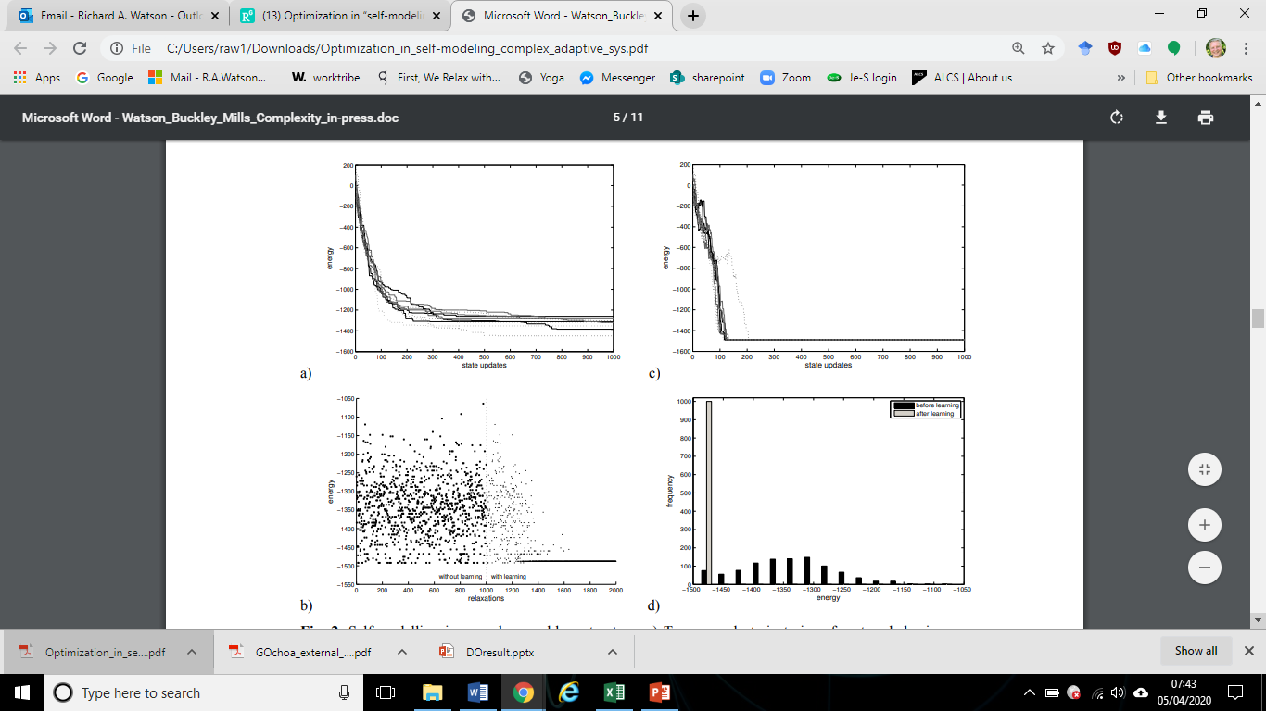
Adaptation by induction
Solns found without learning
Solns found with learning
State dynamics with original weights/ problem constraints
Solutions found before learning
Learns to finds good solutions more reliably
Watson, R.A., Buckley, C.L., Mills, R.M. (2010) Optimisation in ‘Self-modelling’ Complex Adaptive Systems. Complexity. 16(5):17-26.

Slide 30
Adaptation by induction
State dynamics with original weights/ problem constraints
Solns found w/o learning
Solns found with learning
Solutions found before learning
State dynamics with new learned weights
Learns to finds good solutions, quicker and more reliably
Watson, R.A., Buckley, C.L., Mills, R.M. (2010) Optimisation in ‘Self-modelling’ Complex Adaptive Systems. Complexity. 16(5):17-26.

Slide 31
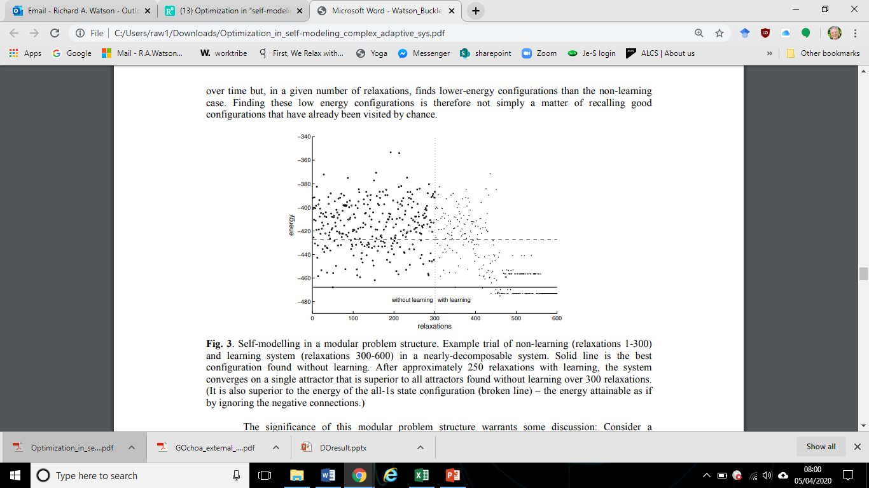
Learning to optimise better
Solns found without learning
Solns found with learning
Finds solutions better than any solution found without learning
With learning

Slide 32
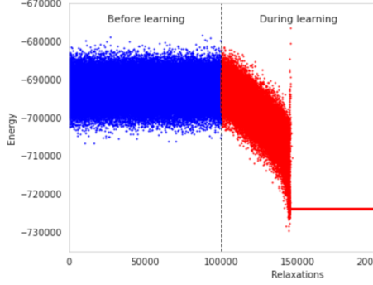
Learning to optimise better (larger system)
Finds solutions better than any solution found without learning
Less frustration between components, more ‘harmony’

Slide 33
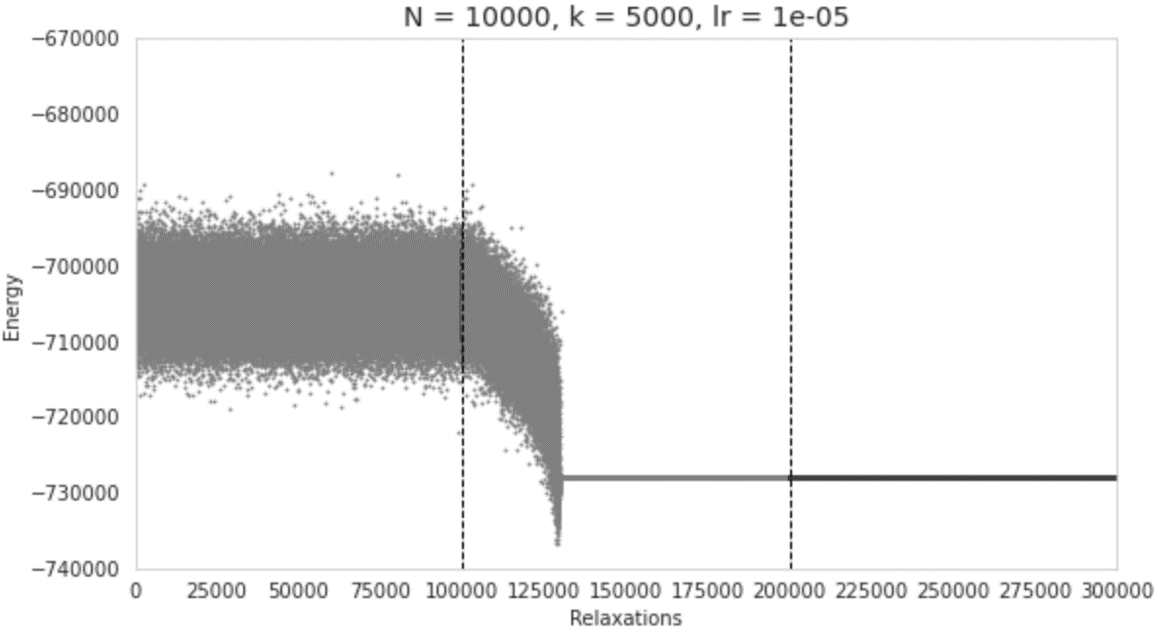
Learning to optimise better (larger system)
Solns found without learning
Solns found with learning
Finds solutions better than any solution found without learning

Slide 34
Without perturbation
Learning requires diverse experiences
Solns found without learning
Solns found with learning
Fixes on an arbitrary solution

Slide 35
Without perturbation
Learning requires diverse experiences
Solns found without learning
Solns found with learning
Fixes on an arbitrary solution

Slide 36
Without perturbation
Learning requires diverse experiences
Solns found without learning
Solns found with learning
Fixes on an arbitrary solution

Slide 37
Learning to optimise better (larger system)
Solns found without learning
Solns found with learning
Less frustration between components, more ‘harmony’

Slide 38
How natural induction works in 4 easy steps
global adaptation ability
✓
✓
Like a learning neural network, naturally (without selection or design).
✓
✓
✓
Networks of viscoelastic connections

Slide 39
The deformation of the springs, or incremental adjustment in the connections to reduce stress, can be provided by
Hebbian learning in a Hopfield network
That’s just what springs do
random variation and selection on connections
Individual utility maximisation (reinforcement learning) if it operates on connections
Needs the system to be repeatedly perturbed
CW option – ‘global adaptation in networks of selfish components’ uses this principle.
Agents change how much attention they pay to each relationship

Slide 40
Brun-Usan, M., Rago, A., Thies, C., Uller, T., & Watson, R. A. (2020). Developmental models reveal the role of phenotypic plasticity in explaining genetic evolvability. bioRxiv. 10.1101/2020.06.29.179226
Brun-Usan, M., Thies, C., & Watson, R.A. (2020). How to fit in: The learning principles of cell differentiation. PLOS Computational Biology, 16(4), e1006811
Buckley, C. L., Kim, C. S., McGregor, S., & Seth, A. K. (2017). The free energy principle for action and perception: A mathematical review. Journal of Mathematical Psychology, 81, 55-79.
Caldwell, J. R., Watson, R. A., …(2018). Deep Optimisation: Solving Combinatorial Optimisation Problems using Deep Neural Networks. arXiv:1811.00784./ EvoStar 2021 conf. paper -> submitted to journal
Davies, A. P., Watson, R. A., Mills, R., Buckley, C. L., & Noble, J. (2011). “If you can't be with the one you love, love the one you're with”: How individual habituation of agent interactions improves global utility. Artificial Life, 17(3), 167-181.
Froese, T. (2018). Ritual anti-structure as an alternate pathway to social complexity? The case of ancient Teotihuacan, Central Mexico. Material Religion, 14(3), 420-422.
Froese, T., & Manzanilla, L. R. (2018). Modeling collective rule at ancient Teotihuacan as a complex adaptive system: Communal ritual makes social hierarchy more effective. Cognitive Systems Research, 52, 862-874.
Kounios, L., … & Watson, R. A. (2016). Resolving the paradox of evolvability with learning theory: How evolution learns to improve evolvability on rugged fitness landscapes. arXiv:1612.05955.

Slide 41
Kouvaris, K., Clune, J., Kounios, L., Brede, M., & Watson, R. A. (2017). How evolution learns to generalise: Using learning theory to understand dev. organisation. PLoS Comp. Bio., 13(4), e1005358.
Levin, M. (2019). The Computational Boundary of a “Self”: developmental bioelectricity drives multicellularity and scale-free cognition. Frontiers in Psychology, 10, 2688. – doi:10.3389/fpsyg.2019.02688
Manicka, S., & Levin, M. (2019). The Cognitive Lens: a primer on conceptual tools for analysing information processing in developmental and regenerative morphogenesis. Philosophical Transactions of the Royal Society B, 374(1774), 20180369. doi:10.1098/rstb.2018.0369
Mills, R. (2010). How micro-evolution can guide macro-evolution: Multi-scale search via evolved modular variation (Doctoral dissertation, University of Southampton).
Mills, R., Jansen, T. & Watson, R.A. (2014) Transforming Evolutionary Search into Higher-Level Evolutionary Search by Capturing Problem Structure. IEEE Trans. on Evolutionary Comp. 18(5), 628-642
Nash, F., Kounios, L., Thies, C., Kouvaris, K., Tarapore, D., Watson, R.A. (2021) Scaling-up evolutionary variability: The causes and consequences of developmental hierarchy, manuscript in preparation.
Power, D. A., Watson, R. A., Szathmáry, E., Mills, R., Powers, S. T., Doncaster, C. P., & Czapp, B. (2015). What can ecosystems learn? Expanding ev. ecology w. learning theory. Bio. Direct, 10(1), 69.
Powers, S.T., Penn, A.S., Watson, R.A. (2011) The Concurrent Evolution of Cooperation and the Population Structures that Support it. Evolution. 65(6):1527–1543.

Slide 42
Rago, A., Kouvaris, K., Uller, T., & Watson, R. A. (2019). How adaptive plasticity evolves when selected against. PLoS Comp. Bio. (BioRxiv, 339622.)
Ryan, P. A., Powers, S. T., & Watson, R. A. (2016). Social niche construction and evolutionary transitions in individuality. Biology & philosophy, 31(1), 59-79.
Watson, R. A. & Pollack, J. B. (2002) A Computational Model of Symbiotic Composition in Evolutionary Transitions. Biosystems 69(2-3) pp. 187-209.
Watson, R. A., Mills, R., Buckley, C. L., Kouvaris, K., Jackson, A., Powers, S. T., ... & Power, D. (2016). Evolutionary connectionism: algorithmic principles underlying the evolution of biological organisation in evo-devo, evo-eco and evolutionary transitions. Evolutionary Biology, 43(4), 553-581.
Watson, R. A., N. Palmius, N., Mills, R., Powers, S. T., and Penn, A. 2009, September. “Can Selfish Symbioses Effect Higher-Level Selection?” In European Conference on Artificial Life (pp. 27–36). Berlin/Heidelberg: Springer.
Watson, R.A. & Szathmáry, E. (2016) “How Can Evolution Learn”, Trends in Ecology & Evolution. 31(2), 147-157.
Watson, R.A. & Thies,C. (2019) “Are Developmental Plasticity, Niche Construction, and Extended Inheritance Necessary for Evolution by Natural Selection? The Role of Active Phenotypes in the Minimal Criteria for Darwinian Individuality”. in Evolutionary Causation, (Uller & Laland). MIT Press.

Slide 43
Watson, R.A., Buckley, C.L., Mills, R.M. (2010) Optimisation in ‘Self-modelling’ Complex Adaptive Systems. Complexity. 16(5):17-26.
Watson, R.A., Mills, R.M., Buckley, C.L. (2011) Global Adaptation in Networks of Selfish Components. Artificial Life. 17(3):147-66.
Watson, R.A., Mills, R.M., Buckley, C.L. (2011) Transformations in the scale of behavior and the global optimization of constraints in adaptive networks, Adaptive Behaviour 19(4): 227-249.
Watson, R.A., Wagner, G. P., Pavlicev, M., Weinreich, D. M., & Mills, R. (2014). The evolution of phenotypic correlations and “developmental memory”. Evolution. 68(4) 1124-1138.

